Slide 1
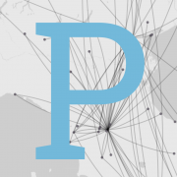
Palladio - Visualize complex historical data with ease
By : Ethan, Logan, Helen and Luke
Notes:
Luke Slide - Part 1

Slide 2
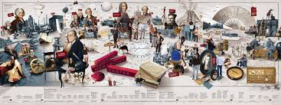
Palladio Introduction
What is Palladio?
Palladio is a digital mapping tool which allows users visualize data onto a map.
Palladio seeks to create a way to map data by designing something with an interface based on humanistic inquiry.
“But it is the way the visualization failed to help us answer actual research questions that made us realize that we needed become actively engaged in the design of tools.”
Visualization tools fail to display effective tellings of historical data/events.
Notes:
Luke Slide - Part 2

Slide 3
The people behind the tool
Created from July 2013 to June 2016
Made by humanities students at Stanford using the NEH implementation grant. Its goal to promote excellence in the humanities and show lessons of american history to everyone
It is a mapping environment along with a data analysis tool which helps to create research based historical interfaces
It also received a Digging into data grant in collaboration with Electronic Enlightenment Project and the Improvise Project for its layouts a few years in
Notes:
Luke Slide - Part 3

Slide 4

Lets see the website…..
Palladio

Slide 5
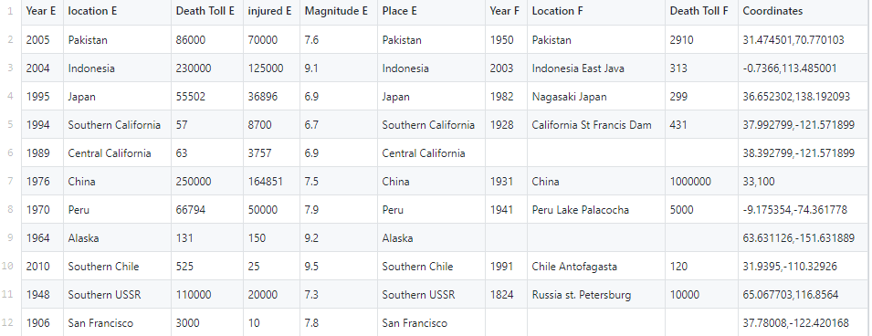
Section two a) https://hdlab.stanford.edu/palladio-app/#/upload
Data required for implementation into Palladio

Slide 6
Research Findings
Palladio provides an interactive map that allows users to coherently visualize the relationship between any two dimensions of data.
Limitations of this tool?
Overall usability
Clean and organized interface
Effective and powerful tool for visualizing different types of data
Hard to understand all it’s features and lacks an effective tutorial
Low efficiency caused by having user manually set every data point
Prone to errors due to the many variables in play for the tool to accurately pinpoint different data points onto the map
Notes:
An interactive map that allow users to coherently visualize and compare large amount of data in a quick grasp.
In our case we analyzed the relationship between natural disasters and death toll
With palladio User are able to switch between different views like Map, Graph, Table, and Gallery to sort and visualize their data according to different dimensions.
For example: would use Map view when needed to compare any coordinates data as data points on a map.
Data points on the map can be sized to represent their relative magnitude within their data.
nodes in Graph view can be scaled to reflect their relative magnitude just like in map view, except it's not on a map
In Table view, data can be arranged to make customized lists
In the Gallery view, data can be displayed within a grid setting for quick reference, data can also be linked to outside web-based information
There are Limitations to this tool
This tool is has a clean and organized interface and its helpful for visualizing the bigger picture when comes to handling large amount of data but
Hard to understand all of this tools features and pinpoint all your data point as the proper data types, take some time to learn Palladio is not the most efficient because user would have to manually set every data point to the proper data type
And the more data point you have the easier is it to make mistakes
Future use of Palladio?

Slide 7
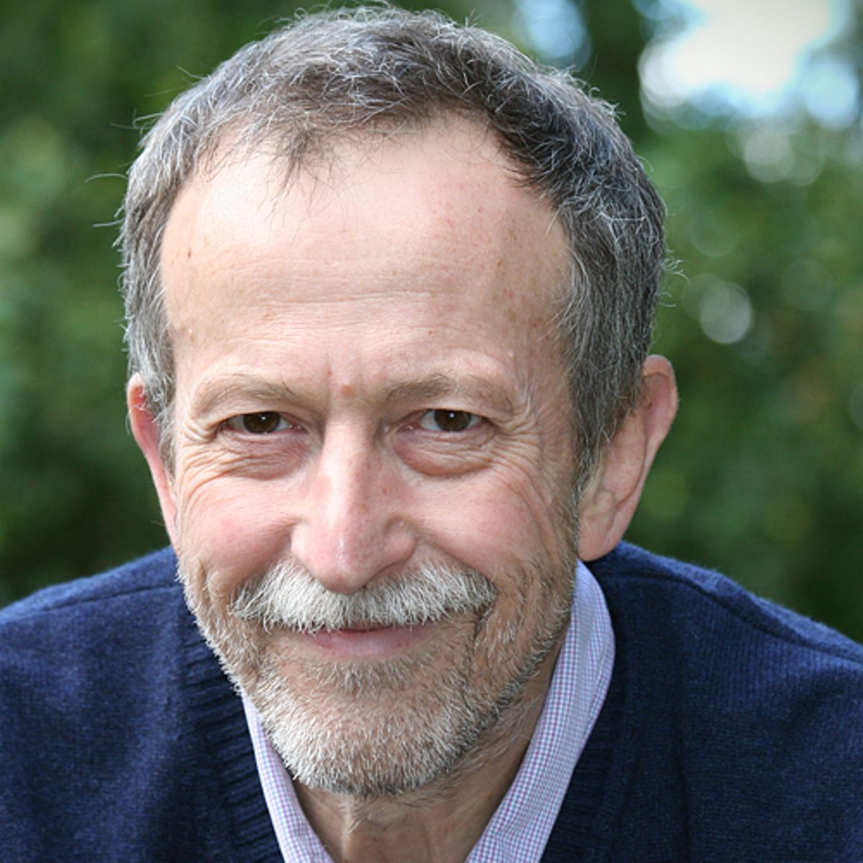
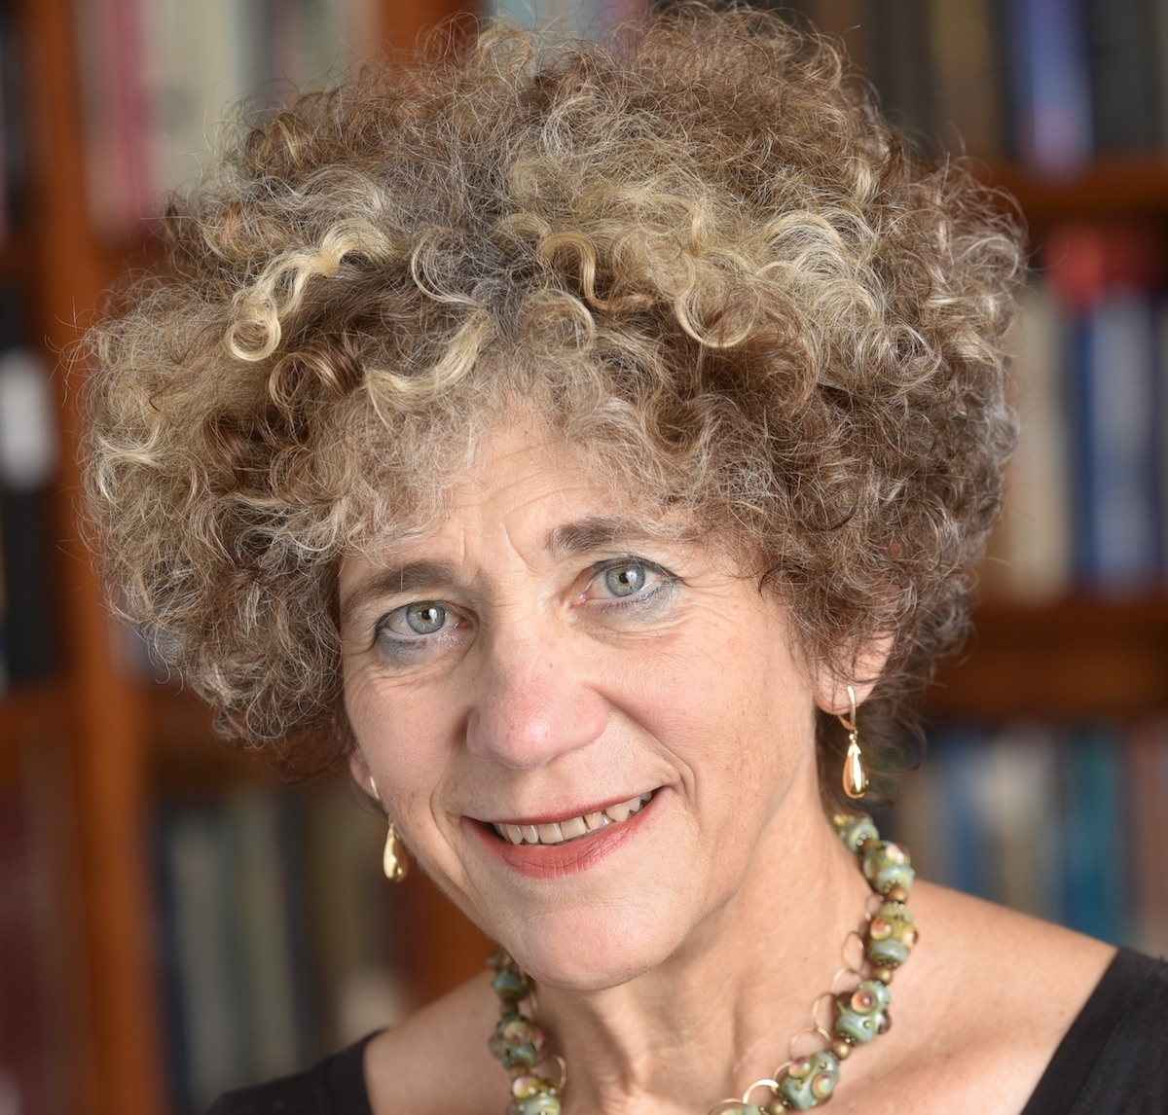
Theoretical Discussion
Old ways of knowledge is getting overrun by cyberinfrastructure (bring history to a digital format to make it visual and easier to understand)
Three different approaches to digital scholarships
Using digital tools ✅
How the tool itself structure knowledge (how does it work and utility) ✅
How tools itself structure perception of the world ❓
Franco Moretti is thinking of scale in a specific period of time
Johanna Drucker: All data is capta because they are captured and experienced subjectively and different for every person
Notes:
Connect to class discussion
Need at least one reading connection
https://mediaproxy.salon.com/width/1200/height/1200/https://media.salon.com/2014/04/franco_moretti1.jpg
https://pages.gseis.ucla.edu/faculty/drucker/JD_Headshot.jpg

Slide 8


Github Collaboration
Able to see real-time contributions and file updates on our branch to ensure everyone is on the same page
Helped each other out by adding to different folders that were visible to each member
Had checkpoints to ensure every group member stayed on track
Notes:
Discuss how your team used GitHub to collaborate
https://www.stickpng.com/assets/images/5847f98fcef1014c0b5e48c0.png
https://sloanreview.mit.edu/content/uploads/2019/08/GEN-Maglio-Collaboration-2400.jpg

Slide 9
Thanks For Listening
Questions?

